Slide 1
US Healthcare Costs: Visualization of Medical Inflation
Noah Eiseman
Will Stephens
Buster Boles
Alison Muller

Slide 2
Healthcare costs are influenced by five major contributors:
Population size
Aging in the population
Changes in disease incidence
Available services and their usage
Service price
Dieleman JL, Squires E, Bui AL, Campbell M, Chapin A, Hamavid H, Horst C, Li Z, Matyasz T, Reynolds A, Sadat N, Schneider MT, Murray CJL. Factors Associated With Increases in US Health Care Spending, 1996-2013. JAMA. 2017 Nov 7;318(17):1668-1678. doi: 10.1001/jama.2017.15927. PMID: 29114831; PMCID: PMC5818797.
Notes:
Definitions:
Size
Aging
Disease incidence
Services available & uses
Price

Slide 3
What are the National Health Expenditures?
Personal health care (PHC)
Health consumption expenditures (HCE)
National Health expenditures (NHE)
Government public health activities
Government administration and the net cost of health insurance
Investment
“Centers for Medicare and Medicaid Services”.cms.gov, 06 Sept 2023
Notes:
PHC - all revenue received from healthcare providers and retail establishments for medical goods and services including non op and non patient monies and philanthropy
HCE - all medical care rendered for the year, (includes all PHC, public health activity, govt admin and insurance cost.
NHE - HCE + investments
Govt public health activities - spending by govts to organize and deliver health services or to control/ prevent health problems
Govt admin - administrative cost of running govt healthcare, AND net cost (premiums - claims) for private insurers
Investment - spending on structures and equipment for non commercialized research, etc.

Slide 4
Data Source
Centers for Medicare and Medicaid
Health Expenditures by state of residence (1980-2020)
Centers for Medicare and Medicaid
“Centers for Medicare and Medicaid Services”.cms.gov, 06 Sept 2023

Slide 5
Topics Queried
Trends
Regional
Expenditure change over time
Different types of expenditures
States with the highest expenditures
States with the lowest expenditures

Slide 6
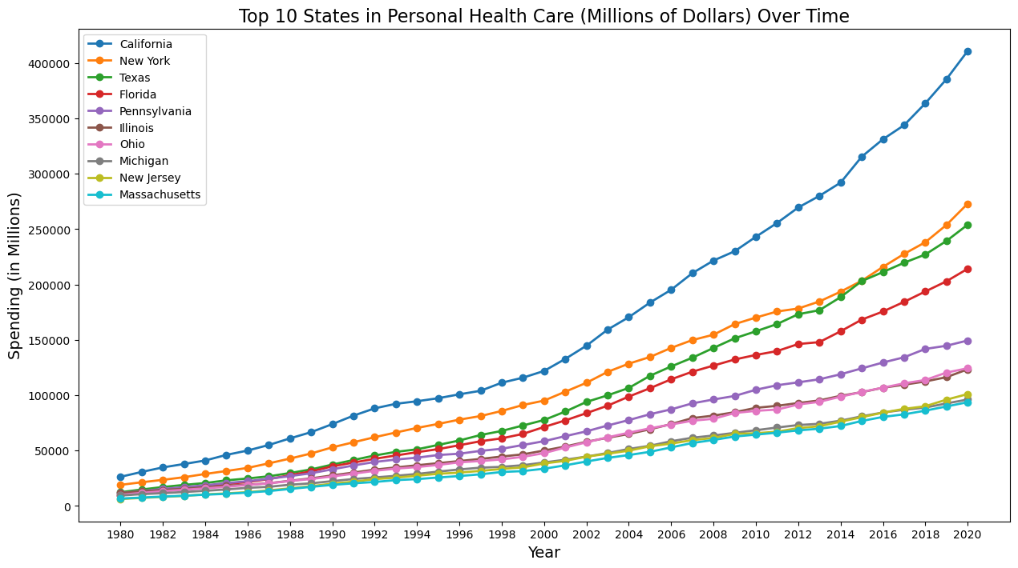
Top 10 States by Spending Category
Chart is available for all 11 spending categories.
There is an overall positive trend in spending with a greater acceleration in spending growth of the last 10 years.
CA, NY, TX, FL, and PA are largest states by population and top 10 spending categories for each item.
The top 5-7 states stay consistent over the spending categories.
Notes:
List the states down here

Slide 7
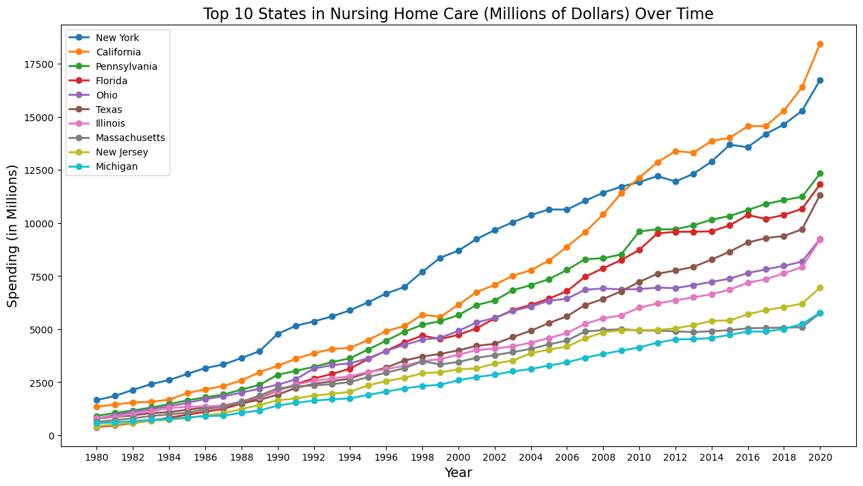
Top 10 States by Spending Category
State | Count
California | 11
New York | 11
Florida | 11
Texas | 11
Pennsylvania | 11
Illinois | 11
Ohio | 11
Michigan | 10
New Jersey | 10
Massachusetts | 5
North Carolina | 3
Georgia | 2
Washington | 2
Minnesota | 1

Slide 8
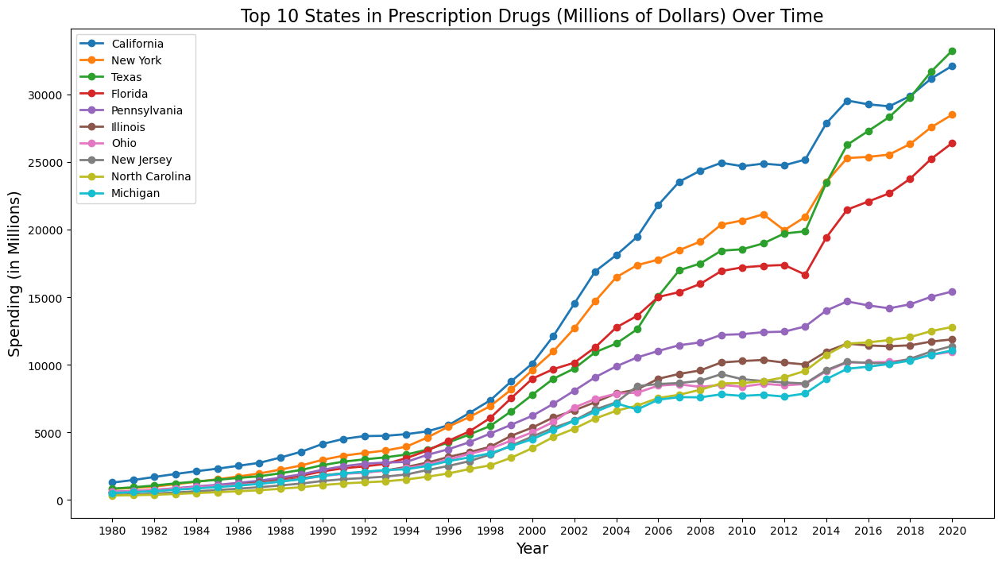
Top 10 States by Spending Category
According to analysis from the Peter G. Peterson foundation, growth in the late 1990’s was attributed to many “blockbuster” drugs being introduced.
These drugs generated over $1 billion and offered treatment for high cholesterol, high blood pressure, acid reflux, and depression.
As these drugs came off patent, spending in many states became more gradual.
Notes:
List the states down here

Slide 9
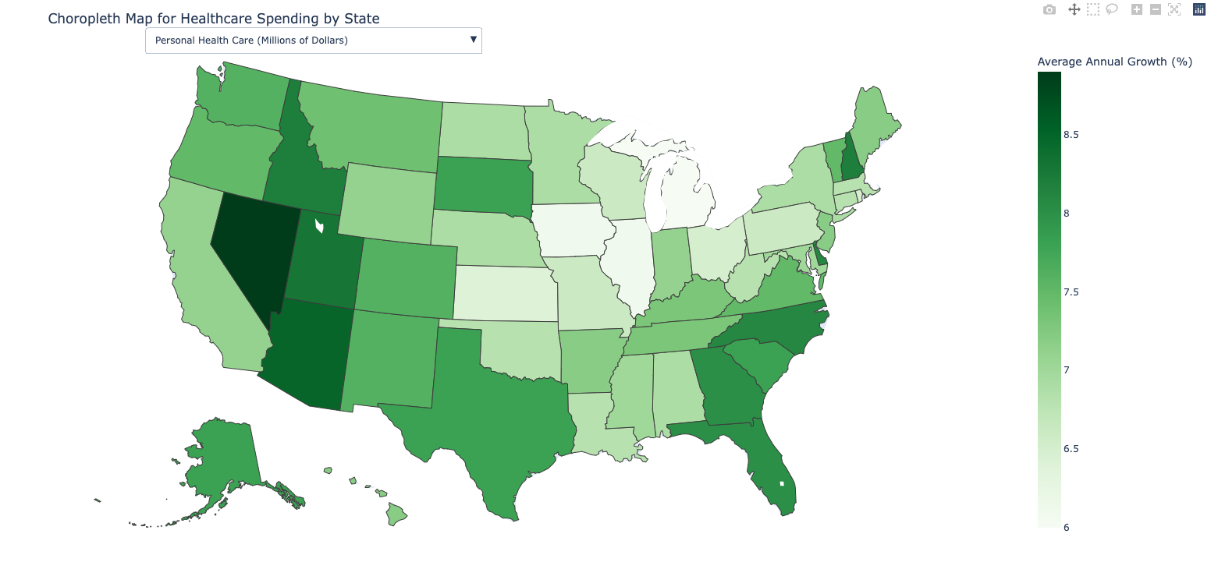
Average Annual Growth

Slide 10


Average Annual Growth - General Trends
The Mountain West and West Coast regions have experienced high growth over the last 40 years. Personal Health, Hospital Care, and Dental Services are driving the increased spending.
Nevada consistently ranks at the top or near the top across all health spending categories. Over each of the last four decades, Nevada’s population has consistently out-growed the broader U.S. population.
Nevada, Florida, and Arizona have the highest annual growth in Nursing Home Care. This is aligned with aging population trends specifically in Florida and Arizona.
The Midwest experienced lower growth relative to other regions across spending categories. Specifically, Michigan, Illinois, and Iowa had grew below 6.5% for Personal Health, Hospital Care, and Physician & Clinical Services.

Slide 11
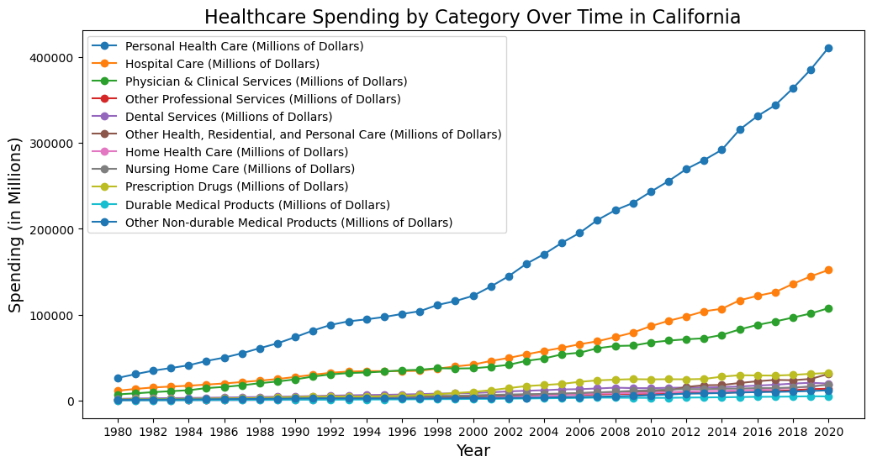
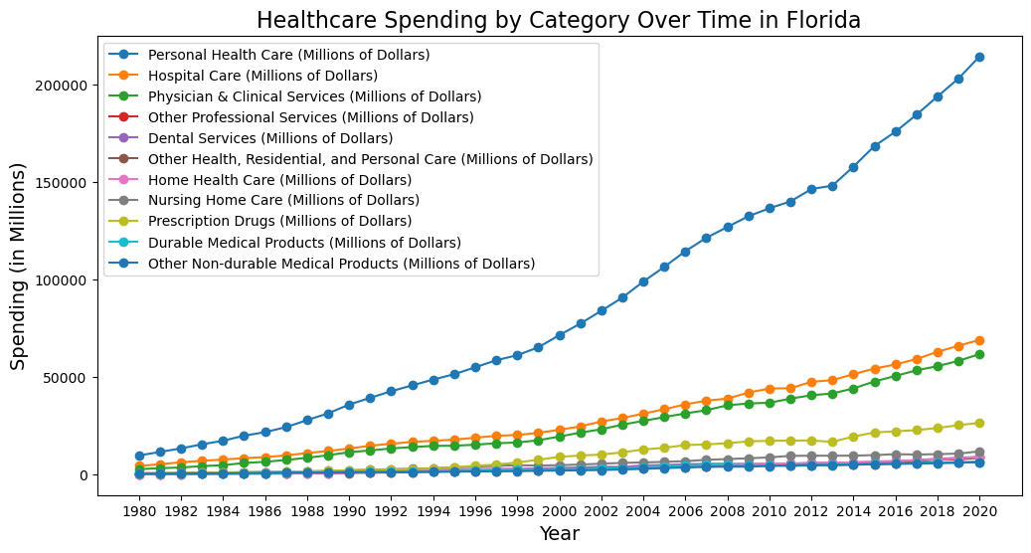
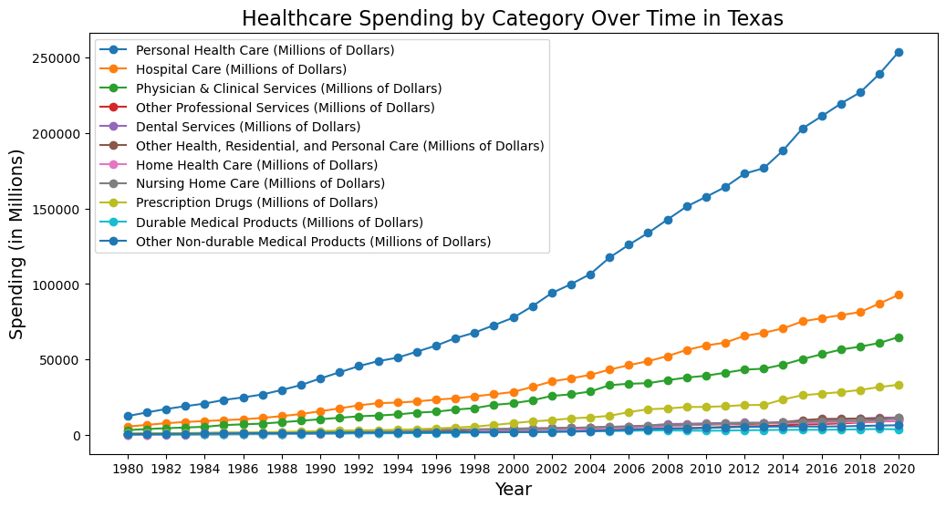
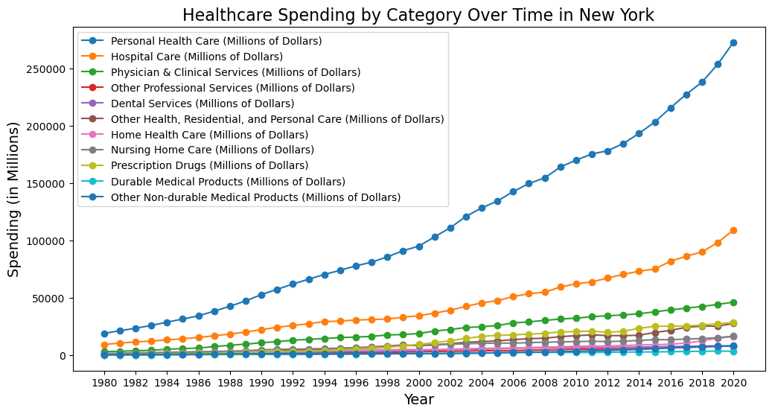
Influence of healthcare cost on areas of dense population

Slide 12
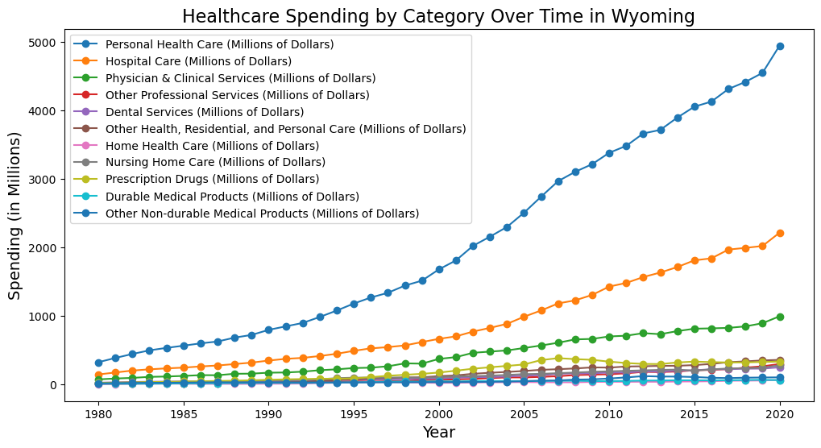
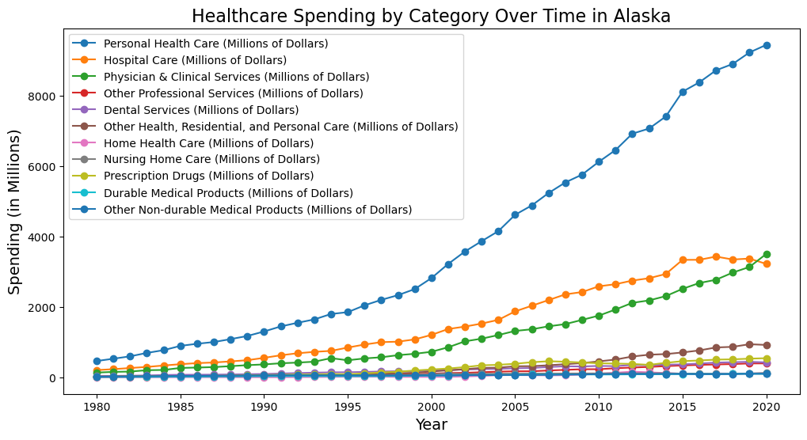
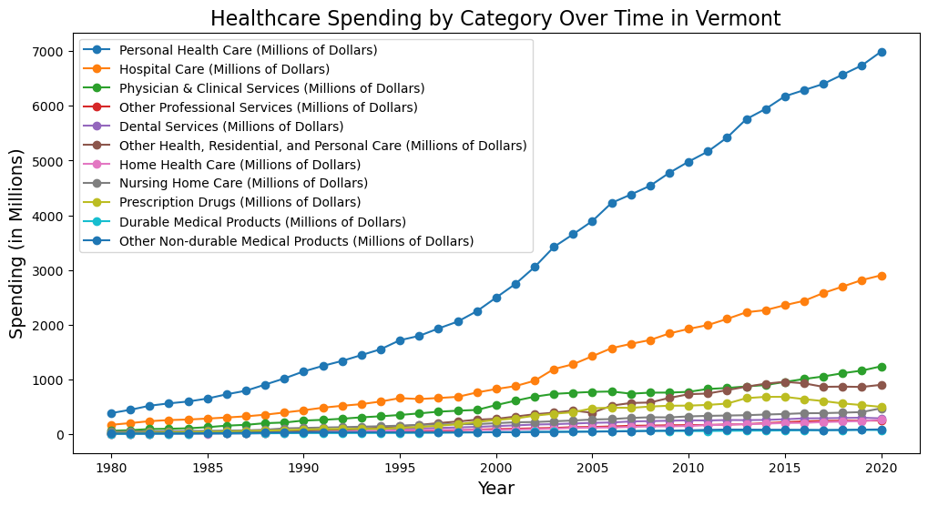
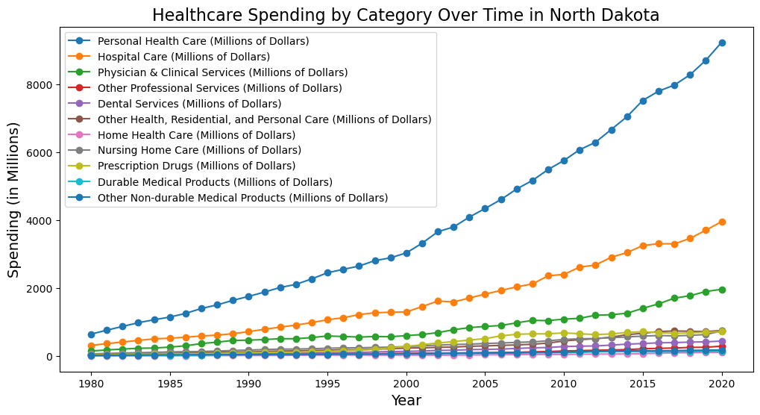
Influence of healthcare cost on areas of sparse population

Slide 13
What happened in Alaska in 2020?
In 2020, Alaska experienced higher spending in Physician & Clinical Services category than Hospital Care.
For all other states examined, Hospital Care had the second highest spending across the 40 year timespan. So, what happened in Alaska?
Medicaid: Unlike most states where Medicare expenditures are higher, Alaska has significantly higher Medicaid payments to doctors compared to Medicare reimbursements. These payments were 56% higher than the national average in 2020. This higher reimbursement rate incentivizes more physician services compared to hospital care.

Slide 14

Bokeh is an interactive library native to Python.
Its strength lies in creating web-ready, interactive graphs that are simple to export as HTML documents, JSONs, or interactive web apps.
This allowed Group 3 to incorporate a Python library that was interactive and not shown in class.
Notes:
We utilized the Bokeh library to create an interactive datatable depicting the summary statics of a given state’s spending across all forms of national healthcare expenditures. Bokeh is an interactive library native to our favorite language, Python. It is simple, easy to use and exports data seamlessly to generate HTML and JavaScript files, launching a new tab to display an interactive graph.

Slide 15
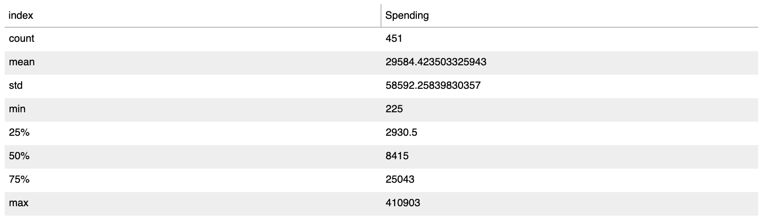
Summary Statistics Table
California Spending Summary
Descriptive Statistics
count: Number of non-null values in each column.
mean: Average value of each column.
std: Standard deviation of each column, indicating how spread out the values are.
min: Minimum value in each column.
25%: First quartile (Q1), representing the value below which 25% of the data falls.
50%: Median (Q2), the middle value in the dataset.
75%: Third quartile (Q3), representing the value below which 75% of the data falls.
max: Maximum value in each column.
To create the table, the .describe() and .reset_index() functions were first applied to the Dataframe.
Notes:
To create the table, the .describe() and .reset_index() functions were first applied to the Dataframe. To quickly refresh everyone’s memory on descriptive statistics, count index is the total number of values, mean is the average, STD is the standard deviation and the minimum and maximum values are the two ends of the dataset.
These are the central tendencies of state spending filtered on state. Here we see the datatable for California, the largest state by population. . It should also be noted that these figures are in millions of Dollars.
Count is the total number of individual expenditures within our dataset,, the PerosnalHealthCare, HealthConsumptionExpenditures, NHE and so on, going back to slide 3. Since this data is limited, each state has a Count index capped at 451. We will see in the following slide that the tables with multiple states have a Count index in multiples of 451

Slide 16
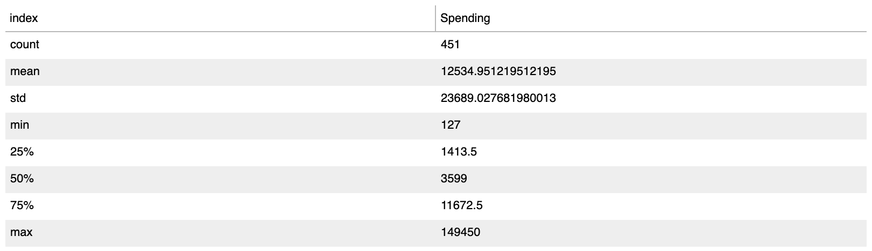

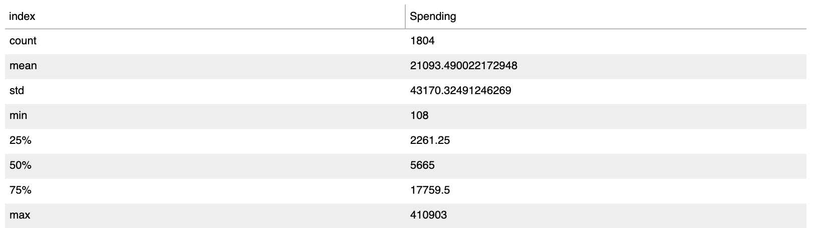
Summary Statistics Comparison Table
Top 4 States by Population
Notes:
The top 4 states by population (CA, TX, FL, NY) filtered on Spending across all categories of healthcare expenditures is shown above. We see that the count is four times the constant 451, 1804. The Mean is 21 trillion and 93 million dollars ,with the MAX value of Fourty-three trillion, one hundred and seventy million dollars. We also see The standard deviation, which ties back to the average annual growth rate Noah mentioned earlier. This is another way to depict the change in spending over time.

Slide 17
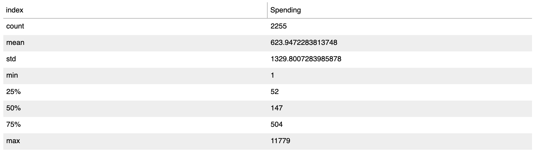
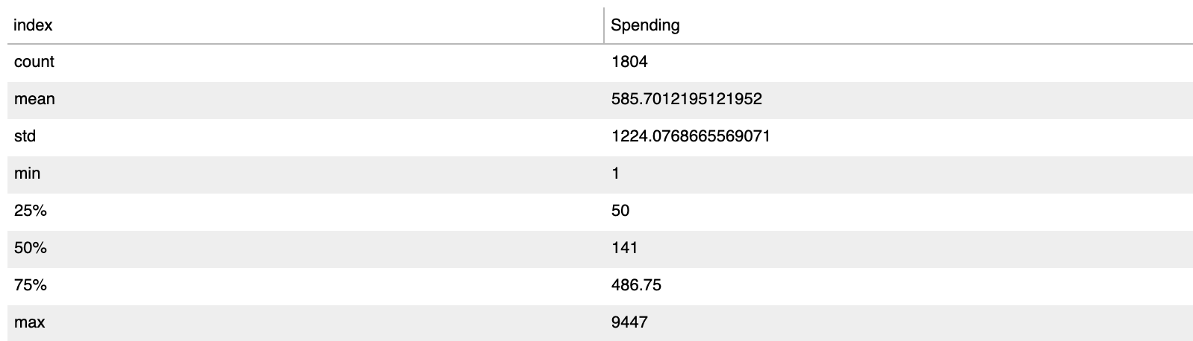
Summary Statistics Comparison Table
Bottom 4 States by Population
Notes:
The bottom 4 states by population (WYoming, VermonT, AlaKsa, NorthDakota) filtered on Spending across all categories of healthcare expenditures is shown above in this slide. Again the Count remains constant, with a mean onf only 585 million dollars among these four states. The minimum is only one million dollars, while the maximum tops out at 9 trillion 4 hundred forty-seven million.
Summary statistics are a great way to generalize data and easy to interpret This helped us to round out our presentation.

